Slide 1
BOSTON HOUSING DATASET
ANKIT RAJ B170236CS
GAURAV KUMAR B170383CS

Slide 2
Contents
Overview of the project
Data Description
Data Exploration
Data Partition
Model Building : Multiple Linear Regression models
Performance of the Model
Conclusion

Slide 3
Overview of the project
The objective of our project is to understand the drivers behind the value of houses in Boston.
The housing dataset contains 506 observations of 14 variables.
As the dependent variable MEDV (Median prices) is continuous, we had implemented the Multiple Linear regression approach.
The project document is organized to demonstrate the entire process right from: Exploring the data, model building, prediction, model performance and understanding the importance of various features in influencing the housing prices.

Slide 4
Data Description
Variable | Description
CRIM | per capita crime rate by town
ZN | proportion of residential land zoned for lots over 25,000 sq.ft.
INDUS | proportion of non-retail business acres per town.
CHAS | Charles River dummy variable (1 if tract bounds river; 0 otherwise)
NOX | nitric oxide concentration (parts per 10 million)
RM | average number of rooms per dwelling
AGE | proportion of owner-occupied units built prior to 1940
DIS | weighted distances to five Boston employment centres
RAD | index of accessibility to radial highways
TAX | full-value property-tax rate per $10,000
PTRATIO | pupil-teacher ratio by town
B | 1000(Bk - 0.63)^2 where Bk is the proportion of blacks by town
LSTAT | % lower status of the population
MEDV | Median value of owner-occupied homes in $1000

Slide 5
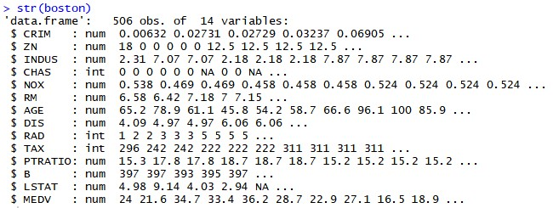
Data Exploration

Slide 6
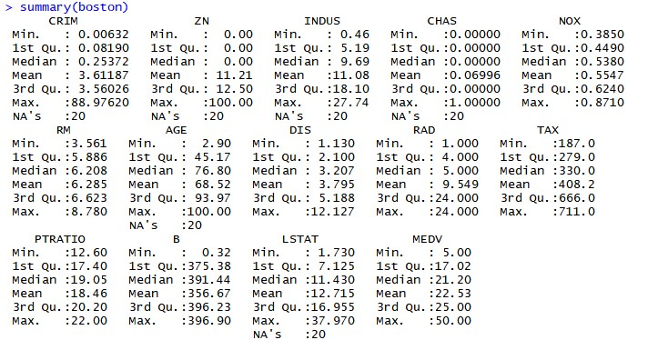
Data Exploration – cont’d

Slide 7
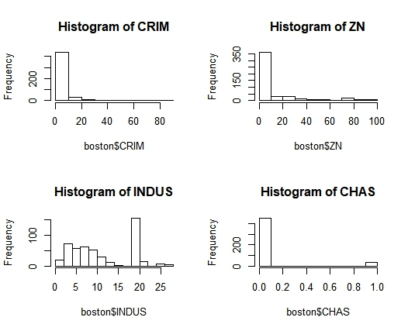
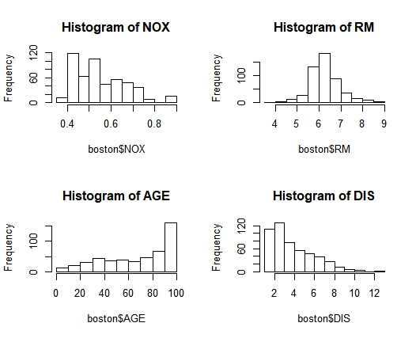
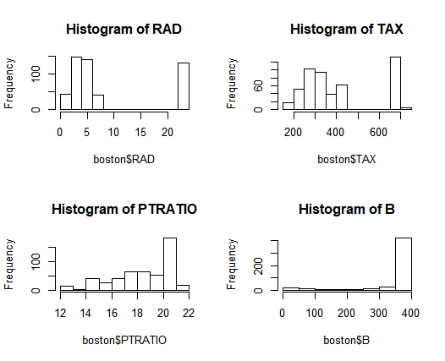
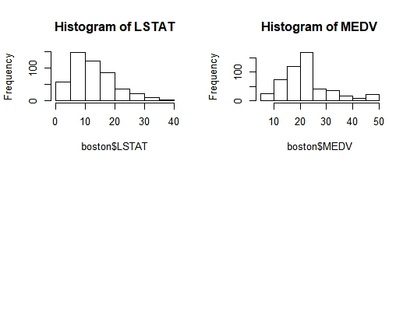
Data Exploration – Histograms

Slide 8
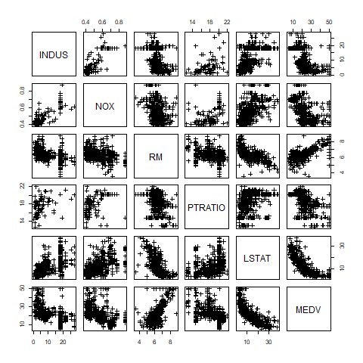
Data Exploration – SCATTERPLOT

Slide 9
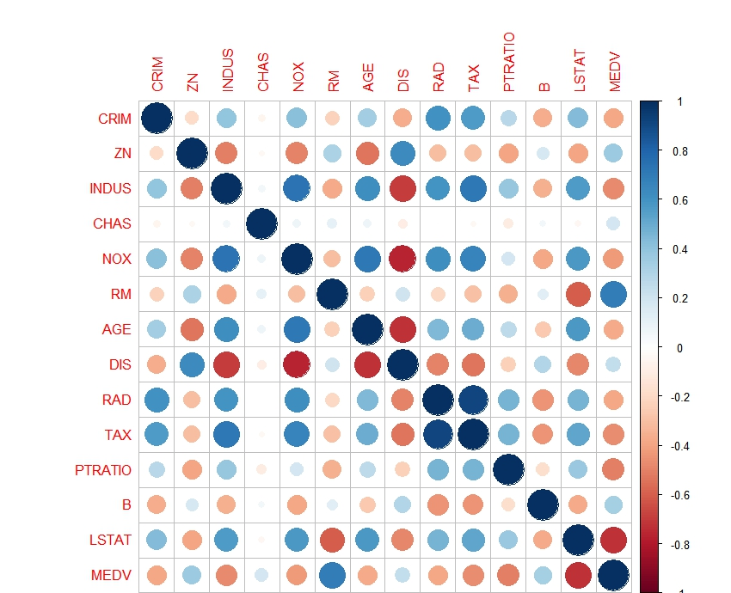
Data Exploration – Correlation Analysis
Positive correlations are displayed in blue and negative correlations in red colour.
Colour intensity and the size of the circle are proportional to the correlation coefficients.
Variables are highly correlated to itself.(example: CRIM with CRIM, ZN with ZN, etc.)

Slide 10
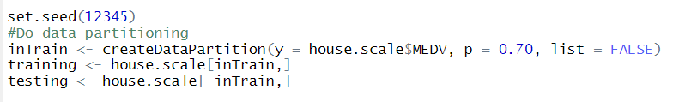
Data partition
We partition the data on a 7/3 ratio as training/test datasets.
The housing dataset is containing now 356 training observations, while the test dataset contains 150 observations. The model will be trained using the train data and will be validated using the test data.

Slide 11
MODEl 1
We try generalized linear regression model with MEDV as the dependent variable and all the remaining variables as independent variables.
Then, we train the model with the training dataset.
OUTPUT :-
RMSE = 4.1871515
R2 = 0.7107889

Slide 12
MODEl 2
We try generalized linear regression model with log(MEDV) as the dependent variable and all the remaining variables as independent variables.
Then, we train the model with the training dataset.
OUTPUT :-
RMSE = 3.5054710
R2 = 0.7628692

Slide 13
MODEl 3 : RANDOM FOREST MODEL
The Random forest model is a type of additive model that makes predictions by combining decisions from a sequence of base models
It operates by constructing a multitude of decision tree at training time and outputting the class that is the mode of the classes (classification) or mean prediction (regression) of the individual trees.
OUTPUT :-
RMSE = 2.6784544
R2 = 0.8197628

Slide 14
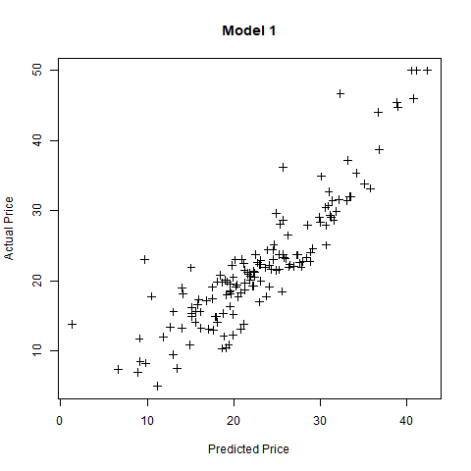
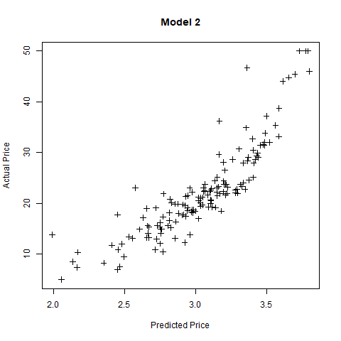
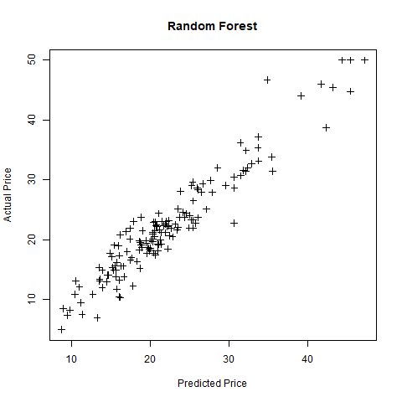
Actual price vs predicted price

Slide 15
Performance of the Model
The RMSE value and Adjusted R-squared value are better in Model 3 compared to other models.
 | RMSE | R2
MODEL 1 | 4.1871515 | 0.7107889
MODEL 2 | 3.5054710 | 0.7628692
MODEL 3 | 2.6784544 | 0.8197628

Slide 16
conclusion
We experimented with various linear regression models and random forest models to predict the housing prices in Boston.
Random forest model with simple linear relationship between the outcome and all input features yielded the best model to predict the outcome with least RMSE.

Slide 17
Thank You!

